Slide 1


Novi koraci u zaštiti hrane…
Notes:
Introduction Comments
The professional of the food industry are force to serve the market with the best products in term of sanitary requirements.
Throughout the food chain, a lot of disposable gloves are in contact with foodstuff. Indeed, they are a critical point because they represent a potential source of contamination (chemical, micro-biological or physical).
In order to reduce these risks, Ansell launch a new range of disposable products : proFood premium.

Slide 2
Pregled
1 – Što je to prehrambena industrija i koje su njene zabrinutosti vezano uz rukavice?
2 – Zašto odabrati proFood i proFood premium
Odobren kontakt s hranom
Bez pudera
Bez plastifikatora
Bez kartona + specifični držač
Raspon više boja
Osobna zaštitna oprema
3 – Proizvodni raspon
4 – Komunikacija i tržišne aktivnosti

Slide 3
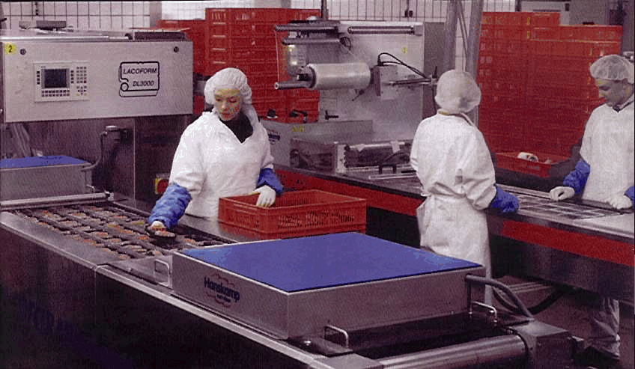
Što je prehrambena industrija?
Prehrambena industrija može se podijeliti u 5 sektora:
Agrikultura: hranitelji životinja, vinogradarstvo,
proizvođači povrća,
Ribarstvo: na moru, školjke i morske trave,
Procesiranje hrane: riba, perad, govedina, svinjetina, procesiranje voća i porvrća, pekarstvo,
Catering: restorani, hoteli,
Supermarketi (interna upotreba),
Veličina tržišta: 8-10 milijuna radnika u Europi
Ansellov tržišni udio: oko 10 %
Notes:
Fragmented market: one of biggest industries in Europe

Slide 4
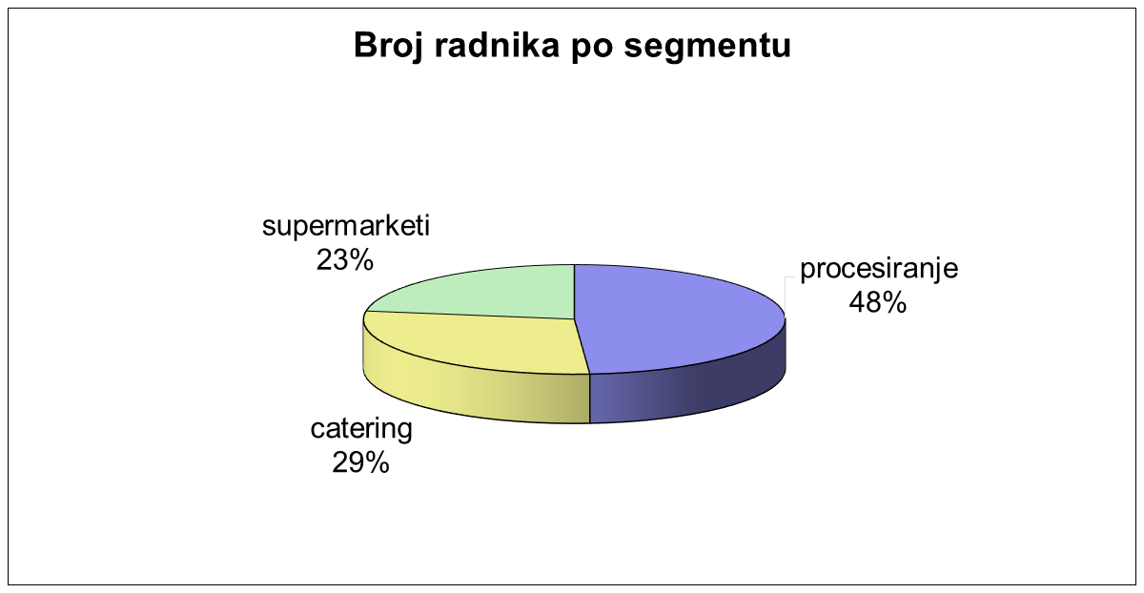
960 000
2 075 000
1 215 000

Slide 5
Zabrinutosti industrije
Tržište
Proizvođači hrane su “odgovorni” za sigurnost svojih proizvoda
Krajnji kupci su osjetljivu na ovu temu
Svjesnost o ovim problemima se povećava
Rukavice: potrošna roba, slaba “vidljivost”.
= izvor fizičke, kemijske i bakteriološke kontaminacije
Konkurentna prednost
Povjerenje u dobavljača je esencijalno
Ekspertnost i znanje
Konzistentnost u kvaliteti
Smanjenje troškova
Notes:
Industry concern is hygiene & food safety
Although needs are comparable across countries, practices are quite varied
Applications/gloves used

Slide 6
Europski propisi
Na rukavice koje se koriste u prehrambenoj industriji primjenjuju se tri europske regulative:
Materijali koji su namijenjeni da dođu u kontakt sa hranom (Propisi o kontaktu sa hranom),
Propisi o osobnoj zaštitnoj opremi,
Higijenski propisi (sanitarni zahtjevi).

Slide 7
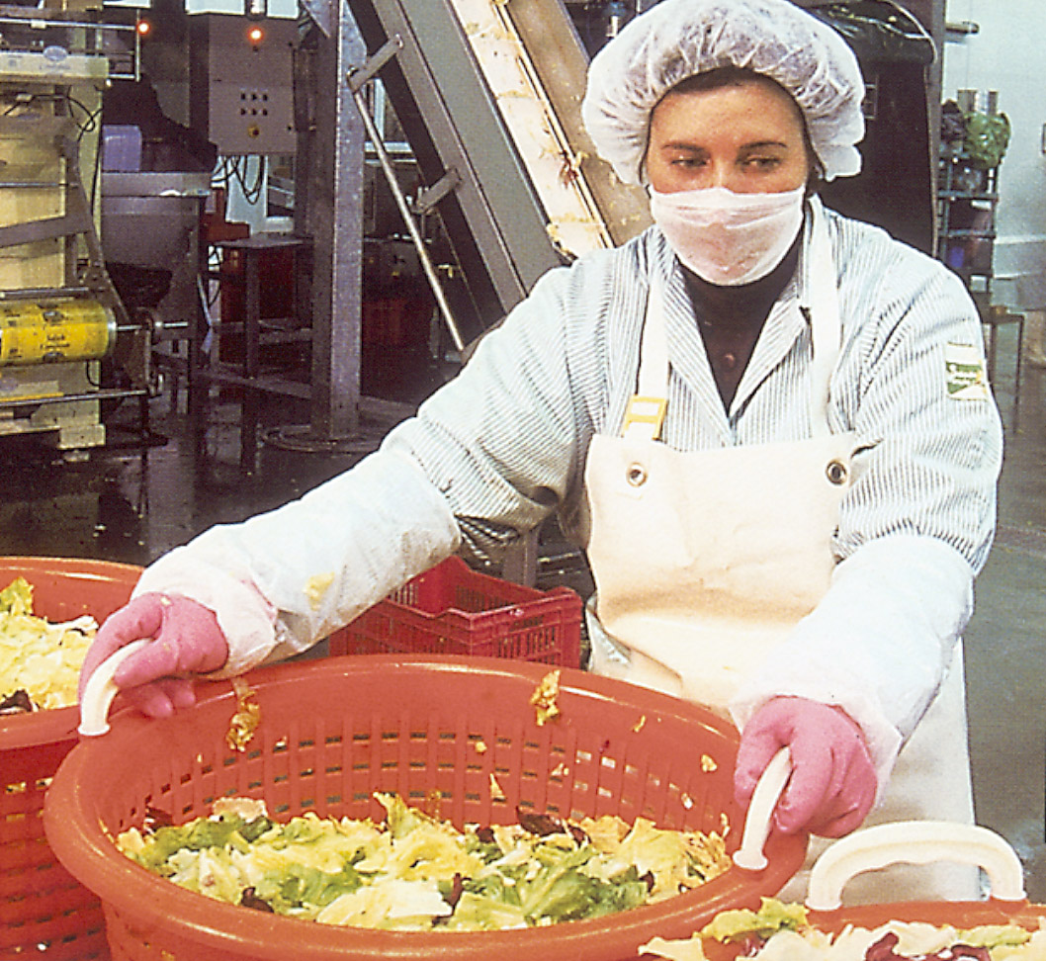
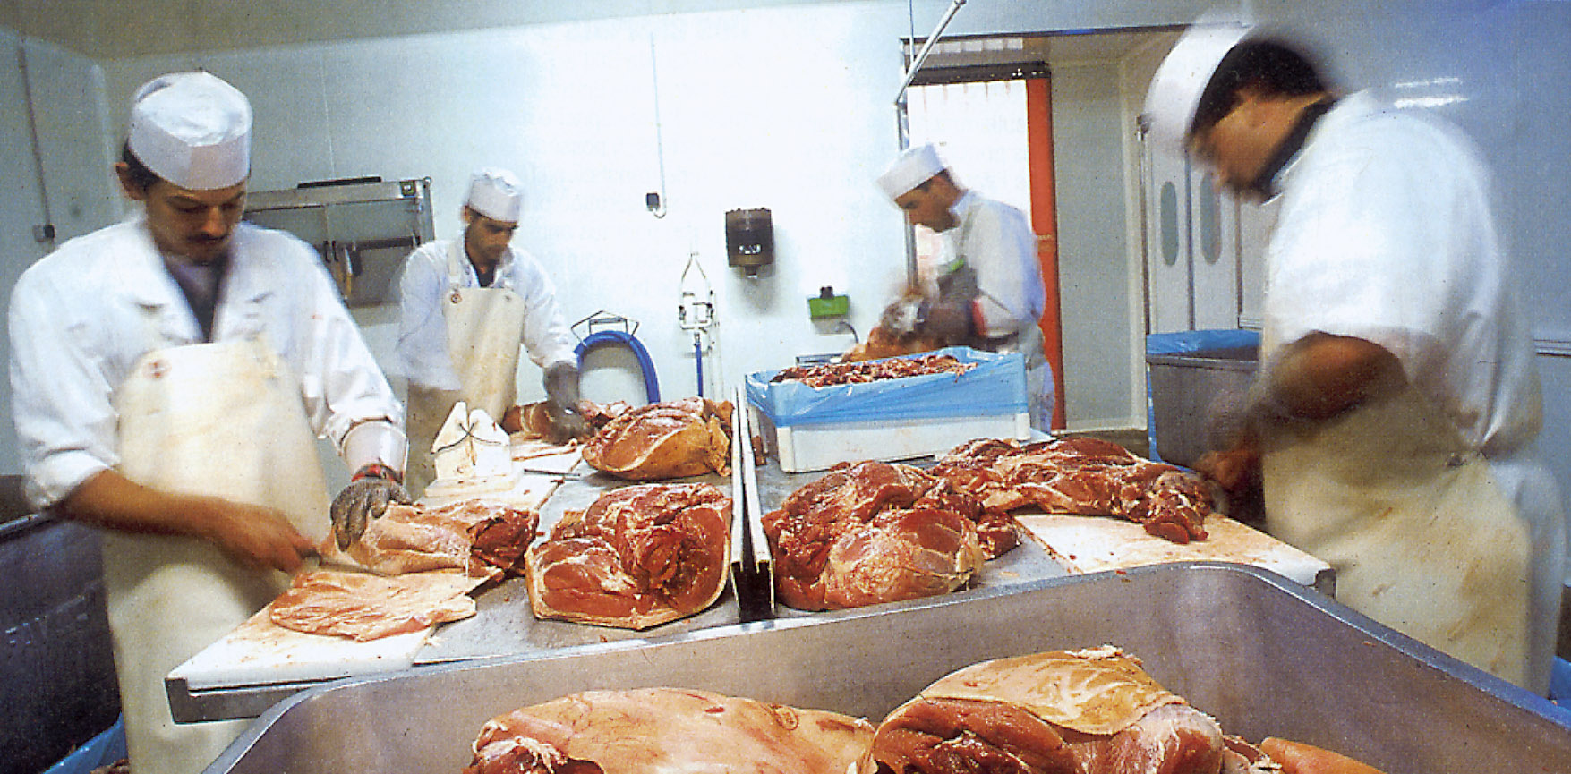
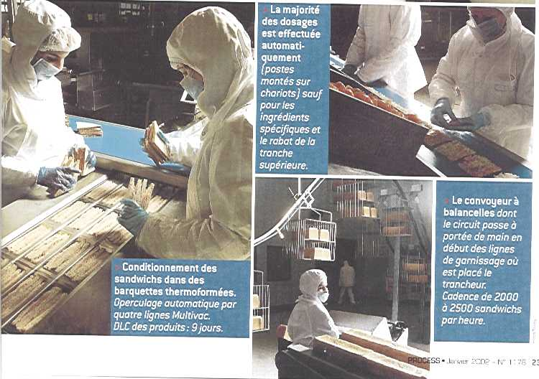
Upotreba rukavica
Druge
- teške aplikacije
- zaštita radnika
Spectra, mješavina lanaca,
drugi materijali
Višekratne
- srednje aplikacije
- zaštita radnika i hrane
HHG, Nitrile, PVC
Jednokratna upotreba
- lagane aplikacije
- zaštita hrane
Nitrile, Latex, PVC, PE

Slide 8
EU pristup
75 % ciljane publike ne zna za Ansell ili proFood
Kvaliteta/Proivodni manager(i)
Radnik Kupac

Slide 9
Zašto odabrati i
Ključne prednosti…
Notes:
Theme : Secure your customer trust
Top 3 features
- powder free
- plasticizers free
- carton free

Slide 10
Lagani, srednje teški i teški proizvodi.
Dozvoljen kontakt sa hranom
Certificirane PPE
godina 2000
Lagani proizvodi
Dozvoljen kontakt sa hranom
Bakteriološki neutralne
Certificirane PPE
godina 2002
Notes:
Comments
proFood is a dedicated trade mark of Ansell,
a range of dedicated products complying with European food contact regulation (in addition to other legal requirements) complying with the needs of the customers : gloves, sleeves, aprons, …
proFood premium
Why some new disposable gloves ?
To answer the significant increase in glove wearers in Services and Food Processing activities
+
To answer the increase in glove consumption
The market has double over the last 2 or 3 years
The reasons of such a trend
Food Scares: (Lysteria etc.)
Implementation of hygiene regulations (Spread of HACCP) (98)
New practices to reduce cross contamination
Use of gloves for shorter time
Change of gloves for every customer

Slide 11
Materijali koji su namijenjeni za kontakt sa hranom
Svaki proizvod (pakiranje, rukavice, nož, boca,…) koji je namijenjen za kontakt sa hranom mora:
1 – mora biti napravljen od dozvoljenih supstanci i aditiva
2 – mora biti u skladu sa svim zahtjevima o migraciji (čestica materijala na hranu)
3 – mora imati prateći dokument i oznaku
Notes:
Directive 89/109/EEC
Ten groups of materials to be covered by specific directives
plastics - regenerated cellulose
elastomers and rubber - paper and board
ceramics - glass
metals and alloys - wood
textile products - waxes

Slide 12
1 – Pozitivna lista autoriziranih supstanci i aditiva
Plastični materijali
pozitivna lista – sekcija A: autorizirani monomeri i supstance ( ~170)
pozitivna lista – sekcija B: monomeri i supstance na listi čekanja (~ 400)
popis aditiva (~700)
popis pigmenata (~130)
Elastomeri i gumeni materijali
pozitivna lista koja nije komplementirana na europskoj razini
komplementirana u Francuskoj, koristeći europske radne dokumente
proFood nitrilni i latex proizvodi certificirani na bazi i u skladu sa francuskim propisima (koji su temeljeni na eruopskim dokumentima)
Notes:
Authorized substances and additives
Plastic Materials (Directive 90/128/EEC)
NB : Application date : 1 January 1993
Elastomers and Rubber Natural latex, Nitrile, …
NB : natural latex and nitrile must be certified for the French market, However, there is no legal requirement in other European Countries until the embrace the legislation fully (12/18 months)!
End-users currently using PVC in many food application do not comply with European legislation.

Slide 13
2 – Zahtjevi za migracije
Migracija je interaktivni fenomen između hrane i rukavica, tijekom koje neki sastavni dijelovi (supstance, aditivi, pigmenti, puder, …) prelaze na hranu i mogu prouzročiti promjenu u kvaliteti, boji i okusu (kontaminacija).
Migracija se mjeri testnom procedurom koristeći simulant umjesto prave hrane.
Simulant hrane je proizvod dizajniran tako da reproducira agresivnost odabrane hrane.
Da bi se pokrili svi tipovi hrane, potrebna su 4 simulanta.
Notes:
Directive 85/572/EEC - - - List of simulants to be used for testing migration of constituents of plastic materials and articles
aqueous foods → distilled water
acidic foods → acetic acid 3%
alcoholic foods → ethanol 10% or adjusted
fatty foods → olive oil or substitute
dry foods → no migration tests
Migration requirements for Fatty food - Reduction factor
Olive-oil is strongly aggressive with materials.
So the migration test result is divided according to the extractive power of the fatty foodstuff. This is called the Reduction Factor.
1 for oil or food in oily medium
2 for butter
3 for fish
4 for meats
5 for cakes and chocolate

Slide 14
2 – Kako izmjeriti migracijsku razinu u kontaktu sa hranom?
uzeti uzorak rukavice od 1 dm² (10 cm x 10 cm),
staviti ga s vanjske strane u kontakt sa odabranim simulantom (120 ml),
ostaviti uzorak u direktnom kontaktu sa simulantom tijeekom:
2 sata na 40 °C za vodu, acetnu kiselinu, etanol i maslinovo ulje,
30 minuta na 20 °C za isooktan,
uzeti uzorak rukavice i ispariti na 240°C,
izmjeriti težinu suhog ostatka uzorka da bi se odredila migracijska vrijednost (mg).

Slide 15
2 – Migracijski zahtjevi
Ukupno testiranje migracije
rukavica ne smije prenijeti svoje sastavne dijelove više od 10 mg/dm²
test se vrši sa svakim od 4 simulanta (ovisno o zahtjevima proizvođača)
Specifični limiti migracije
upotreba mnogih sastavnih dijelova rukavice je povezana sa spefičnim migracijskim ograničavajućim funkcijama “otrovnosti” sastavnog dijela (okus, boja, kvaliteta,…)
test se vrši sa svakim od 4 simulanta (ovisno o zahtjevima proizvođača)

Slide 16



2 – Ansell-ova proFood piktogramska tabela

Slide 17






Slide 18

3 – Informacije za tržište
Svaki proizvod koji je namijenjen za kontakt sa hranom mora imati zakonski određene prateće stvari:
simbol hrane ili riječi “za upotrebu sa hranom”,
ako je potrebno, specijalne uvjete ili restrikcije kod uporabe,
identifikaciju proizvođača ili njegovog legalnog zastupnika unutar EC:
na prodajnoj razini: na samom proizvodu,
u drugim marketinškim fazama: na samom proizvodu ili na pridodanim dokumentima i izdanje pisanog atesta.

Slide 19
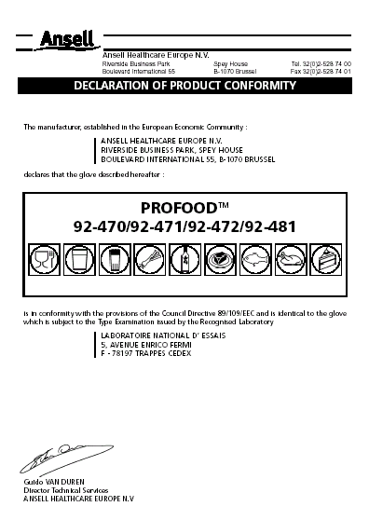
3 – Deklaracija za kontakt sa hranom
Auto-certifikacijski proces, ali primjenjuju se stroge odrednice.
Naši proizvodi su testirani od strane nezavisnog francuskog laboratorija, Laboratoire National d’Essai (LNE), poznatog po stručnosti za europske odredbe i kontakt sa hranom.
Odredbe za kontakt sa hranom strogo se prate u raznim europskim zemljama.

Slide 20


proFood premium = dozvoljen kontakt sa hranom
smanjeni kemijski kontaminacijski rizici: kontrolirani sastav rukavica i limitirana razina migracije,
odgovarajući odabir materijala rukavice: lagana za korištenje Ansell-ova piktogramska tabela,
obećanje proizvoda: performanse/kvaliteta.
Notes:
Comments
2 years ago, with our proFood range, we promote some gloves needed to improve Safety & Hygiene :
- right composition of our products versus the food contact : chemically neutral,
- right compatibility in between the different foodstuff and our glove material : chemically neutral
- respect of the more stringent standards.
Directive 89/109/EEC Materials and articles intended to come into contact with foodstuffs
Every product (packaging, gloves, knife, bottle,…) intended to come in contact with foodstuffs has to:
- be exclusively made from authorized substances and additives
- comply with all migration requirements
- be accompanied by the required documents and marking
Reinforce the importance of the chemical composition of the glove and the purpose of the migration limits.
All our gloves are chlorinated : reduction of contamination at production and migration into food

Slide 21
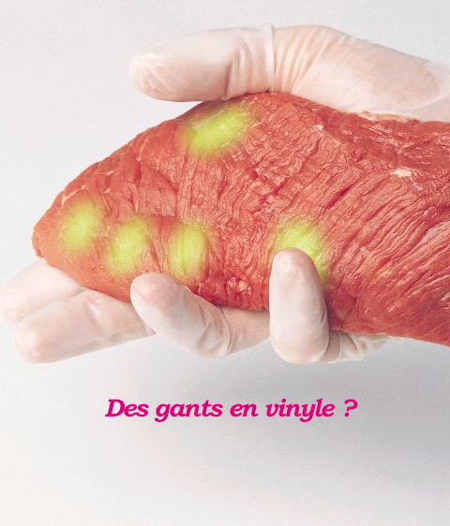
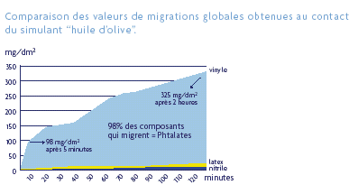
Usporedba ukupnih migracijskih vrijednosti izvedena sa
simulantom “maslinovo ulje”
325 mg/dm²
nakon 2 sata
98 % materijala koji migrira= Phtalates
98 mg/dm²
nakon 5 minuta
Vinylne rukavice ?
proFood premium = bez plastifikatora
smanjenje kemijske kontaminacije,
bolja kompatibilnost hrane - moguć je kontakt sa masnom hranom.
Notes:
Vinyl gloves ? Or
Gloves without vinyl in order to reduce chemical contamination
Once again, our tests are formal. During food handling activities, plasticizers (phtalates belong to this family) that represent more than 40 % of vinyl gloves migrate into foodstuffs and especially with fatty ones like oils, meats and fishes. As a precautionary initiative, we have banned the vinyl gloves of our proFood premium range of products.
Following these results, only the most safe material regarding food contact have been selected : Natural Rubber or Nitrile.
proFood premium = Plasticizers Free
PVC Glove Composition
PVC as % of weight = 50-60% --> raw material : vinyl chloride monomer (carcinogenic)
Plasticisers or Softeners, as % of weight = 35-50%
Phtalates = 95 % of plasticizers used in glove (DEHP, DINP, …)+ Others (TXIB, DEHA)
Other additives (pigments, accelerators, stabilisers, etc.) as % of weight = 1-5%
PVC and Food contact
Estimated Migration levels for PVC gloves in contact with fatty foodstuff are :
- 10 times more important than the ones tolerated for disposable PVC gloves,
- estimated to 20 - 25 % of the total glove weight,
- the thicker the glove, the more important the migration
- the migration rate is higher is the first few minutes of contact

Slide 22






0493
proFood premium (PPE)
zaštita za radnika od industrijskih rizika(posjekotina, kemikalija, vrućine i hladnoće),
proizvod III kategorije: EC tip provjere + ISO 9002 proizvodne lokacije,
konzistentnost performansi: rukavice se testiraju svake godine od strane Centexbel-a, nezavisnog laboratorija.
Notes:
Comments
proFood premium
All gloves are chlorinated at the end of the manufacturing process
- improved chemical resistance
- reduction of migration when in contact with food
- Elimination or drastic reduction of either chemical, physical or microbial contamination that may occur along the previous process stages

Slide 23
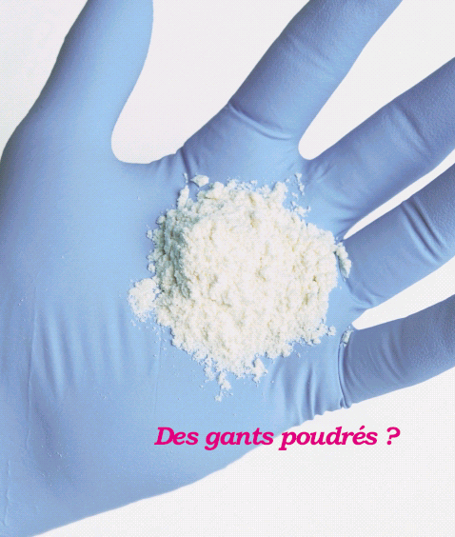
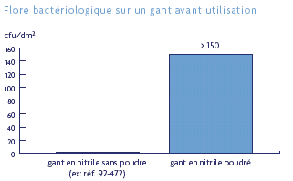
Bakteriološka flora na rukavici prije upotrebe
Powdered gloves ?
Nitrilna rukavica bez pudera
92-472
Nitrilna rukavica sa puderom
proFood premium = bez pudera
nizak udio bakteriološke flore, blizu neutralnom,
manje kontaminacije hrane, kao i radne okoline,
smanjuje rizike alergija i kožnog dermatitisa.
Notes:
Powdered gloves ?
Or
powder free gloves that can reduce the bacteriological risk.
Some studies done in an official laboratory confirmed this statement. Powdered gloves support a bacteriological flora that can contaminate, just by one contact, any foodstuff touched.
-->92-472’s contamination is inferior to 1 bacteria/dm² (lab can not guarantee 0)
--> Nitrile powdered’s contamination is superior to 150 bacteria/dm² (lab can not count over 150).
In addition, elimination of GMO concerns associated to corn starch

Slide 24
Sve brojke su u CFU / dm² vanjske površine rukavice- Testovi napravljeni u nezavisnom laboratoriju.
Bakteriološki neutralne Dokaz pomoću testova
Notes:
Comments
1 glove = 3 dm²
The information shown on the previous graph were related to nitrile gloves but the same conclusion could be dressed with Natural latex and PVC gloves.
In order to minimize this risk, all our proFood premium gloves are powdered free.
proFood premium powder free disposable gloves are bacteriologically neutral
proFood premium = less contaminate the foodstuff
Weight of the powder per glove = less environment contamination
proFood premium = less allergies and less skin dermatitis
Powder free gloves limit the risk to develop allergies and cutaneous reaction for the glove wearers.
Because, corn starch powder act as
- an abrasive agent that can cause contact dermatitis,
- a support for the natural latex proteins when the glove is made of natural rubber.

Slide 25
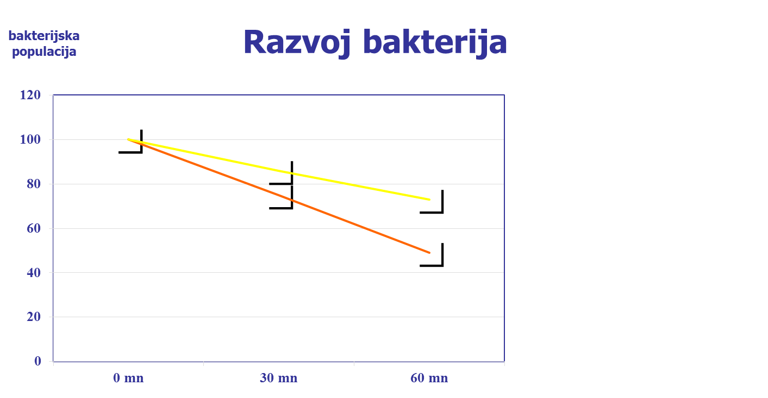
Prirodni latex 69-465
bez pudera
Nitril 92-472
bez pudera
vrijeme trajanja
Nitril bolje limitira razvoj bakterija nego prirodni latex
Notes:
Some objections regarding bacteria’s importance in the food industry
This is not a problem for me, my factory is at 3°C. The bacteria's will not grow.
Cold inhibits germs but does not kill them.
The hand of the worker is at 25°C + humid + food presence.
Once transmitted to food they could develop later (during transport, at home, etc.)
Anyway, all my products are frozen, so no problem.
Once defrozen, they will grow.
Not an issue, all my products are cooked at the end.
This is fine. But, how do you handle/pack cooked foods? How is the cooking done? for how long?
Yes, but are these germs pathogenic or spoiling?
Even if not pathogenic, total bacteria count in food is used by most inspectors as an indicator of quality control in the factory.
Most germs could be pathogenic: it depends on the quantity and the health condition of the consumer

Slide 26
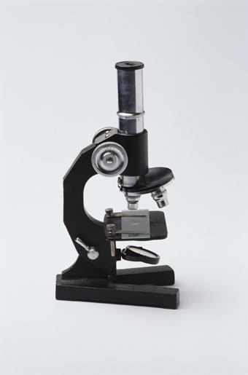
Zašto treba misliti na mikrobiološku kontaminaciju?
Tehnička podrška
za promociju proFood Premium raspona rukavica

Slide 27
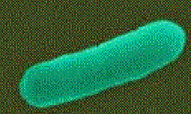
Što je mikro organizam?
To je jedna stanica nevidljiva za golo oko (veličina < 0.1 mm).
Živa je:
Jede,
Pije,
Treba određene životne uvjete: temperaturu i kiselost (pH),
Razmnožava se,
Kreće se,
Organizirana je.
Notes:
The science that is focus on micro-organisms or microbes is Microbiology : science of the very little beings.
Eat --> Nutrients are necessary : macro & micro elements
Drink --> Humidity is needed for their life
In brief and to be simple, when we want to understand the world of micro-organisms, we can compare them to the human populations … this includes their adaptability.

Slide 28
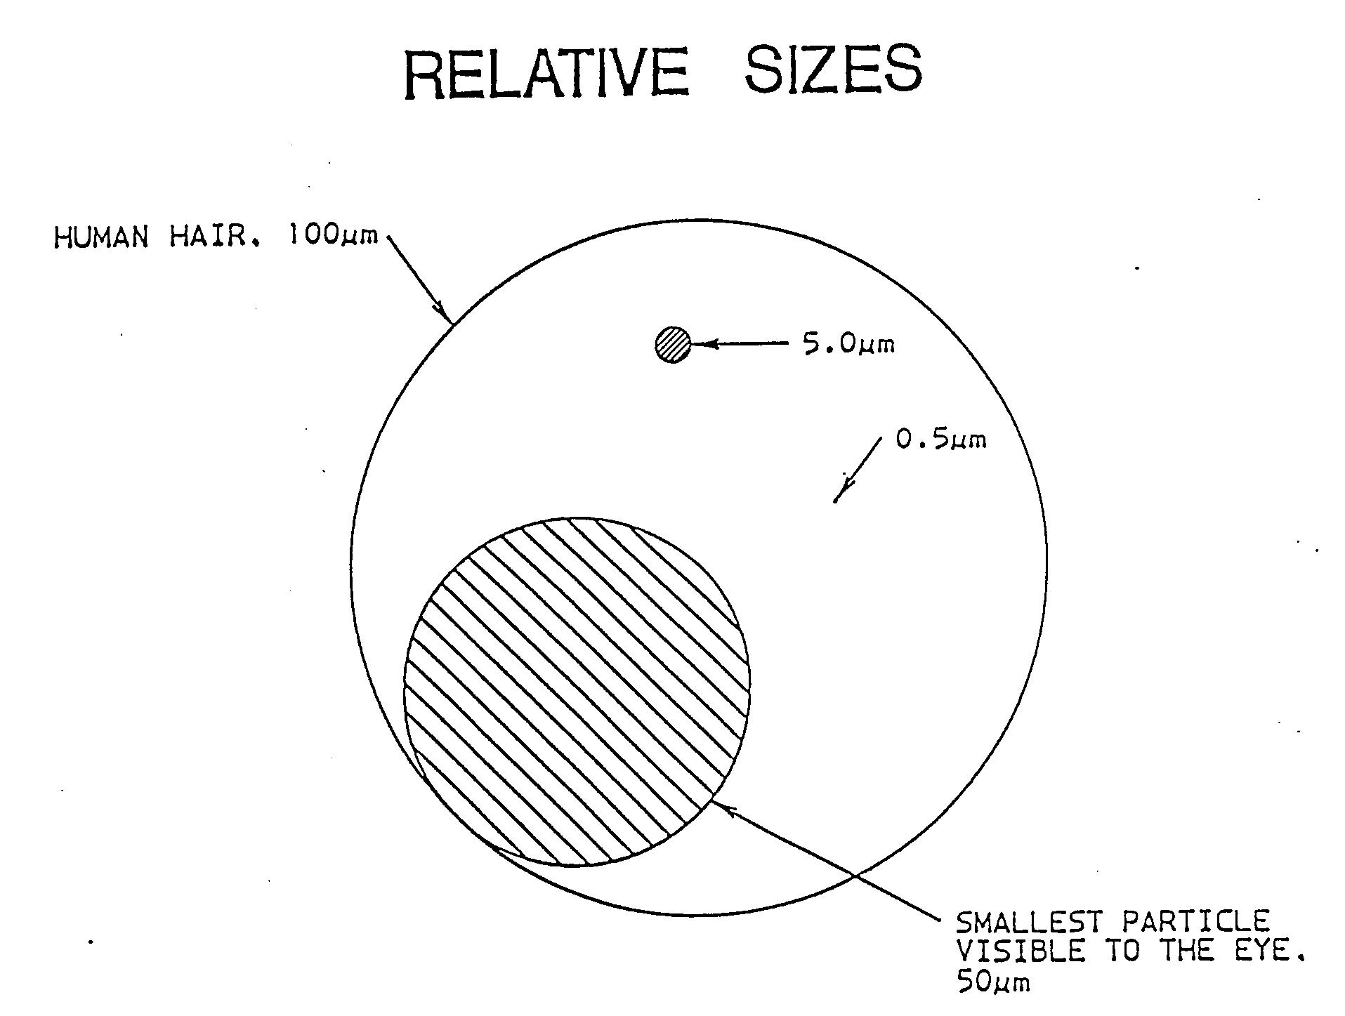
SMALL BACTERIA

Slide 29
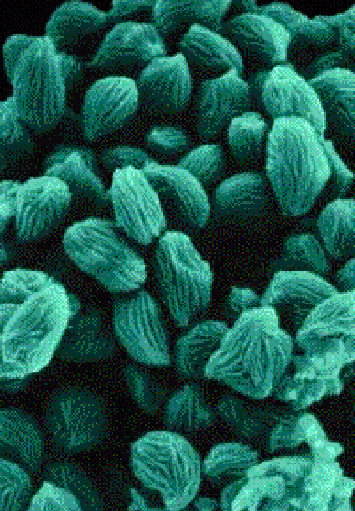
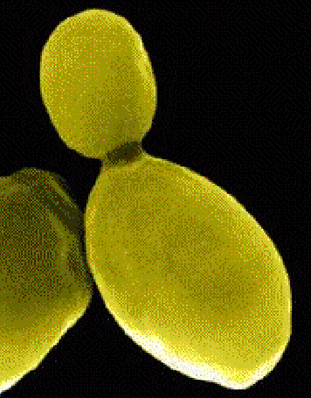
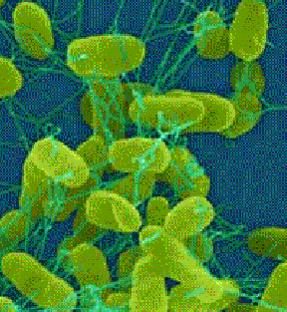
Utjecaj tih organizama na hranu
POZITIVAN
Neophodan za proces
Kvasac
Saccharomyces Species
vino, pivo, kruh
NEGATIVAN
Propadanje hrane bez opasnosti po ljude
Gljivice
Rhizopus Stolonifer
kruh,...
OPASAN
Patogenski efekt na ljudsko tijelo
Bakterija
Salmonella Species
sirovo meso, jaja,...

Slide 30
Vrijeme potrebno za novu generaciju mikroorganizama

Slide 31
Kontaminacija hrane mikroorganizmima: dozvoljene granice.
Ukupna kontaminacija
Ukupan broj živućih stanica
Granice su fiksni od zemlje do zemlje i ovisno o kategoriji hrane
Europa/mljeveno meso: 500 000 cfu/g
Specifična kontaminacija
Broj specifičnih stanica
Granice su fiksne u raznim zemljama
Listeria monocytogenes: od 0 do 100 cfu/g u SAD, Kanadi i EU
Salmonella: Europa 0 cfu/g
Escherichia coli 0 157:H7: Francuska 0 cfu/g

Slide 32
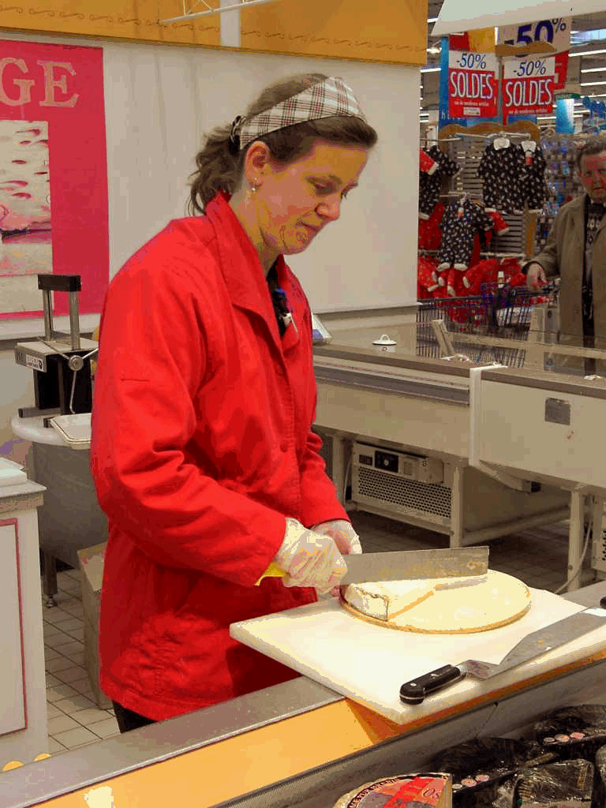
Ljudska kontaminacija
Područje kose 1 000 000 / cm²
Koža na čelu 100 000 / cm²
Izlučevine iz nosa 10 000 000 / g
Slina 100 000 000 / g
_____________________________
Ukupno 100 000 000 000 000
Normalna kontaminacija
na, i u zdravom tijelu
Notes:
A human being is made of 10 000 000 000 000 cells.

Slide 33
Kako zaštititi hranu od tih mikroorganizama?
Izbjegavati kontakt
Radnikove odjeće i rukavica
Poštivanje HACPP plana
Inhibicija
Narušavanje njihovog okruženja
Kemijske akcije: bakteriostatik
Uništavanje
Vrućina
Kemijske akcije: baktericid
Zračenje
Notes:
Comments
INHIBITION - - - Time of life when inhibited : up to many years
Perturbation of their environment : when stressed (lack of humidity, nutrients or temperature) a micro-organism changes into a spore : it becomes inactive but stays alive.
Working environment is around 4°C --> inhibition of bacterias growth (but some of them like listeria will still continue to grow !!!)
Chemical action : Bacteriostatic chemicals inhibit the growth of micro-organisms.
DESTRUCTION
Heat : Most of them are killed when submitted to a temperature of 70-80°C during 2 minutes.
Remark : some of them are resistant up to 100-120°C
Chemical : Bactericide chemicals kill the micro-organisms and their spores

Slide 34
Direktiva o higijeni hrane
Treba poštivati direktive EN 29000 -1 do 4
Jednako do ISO 9000 -1 do 4.
Moraju se primjenjivati dobre proizvodne metode (HACCP)
Sve mjere moraju se uzeti u svim fazama pripreme, procesiranja, pakiranja, spremanja, rukovanja i nuđenja na prodaju da bi se osigurala sigurnost hrane
Potrošači moraju biti zaštićeni od mogućih štetnih posljedica hrane
Svaka osoba koja rukuje hranom mora nositi odgovarajuću odjeću
Notes:
Dir 93/43/EEC

Slide 35
Odgovornost prehrambene industrije
Profesionalac
(obrađivači hrane, distributeri hrane, …)
ima obvezu rezultata…
odgovoran je za svaku nezgodu
…čak i bez prethodne pogreške...

Slide 36
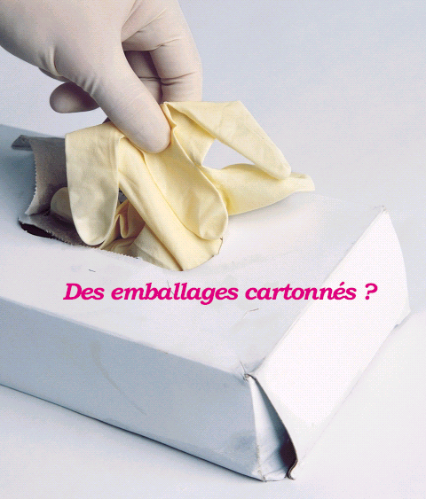
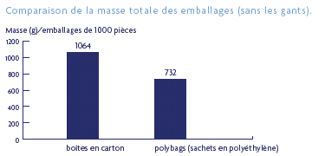
Usporedba ukupne težine pakiranja (bez rukavica)
Težina (g) / pakiranje od 1000 komada
Carton dispenser ?
kartonski dispenzeri
poly-vrećice (PE vrećice)
proFood premium = bez kartona
pušta manje čestica u zrak prilikom otvaranja,
sistem za lagano otvaranje i laganu kontrolu razine korištenja,
smanjenje volumena i nepotrebne težine smanjuje troškove održavanja,
poly-vrećice se rade od ne-apsorbirajućeg materijala koji se može koristiti u mokrom ili masnom okruženju.
Notes:
Carton Dispenser or PE polybags, Good characteristic to decrease contamination and Cost
This new packaging consists in a 30 % reduction of total packaging weight.
If you compare the dispenser packaging data : more than 80 % reduction :
- carton dispenser weight : 684 g / 10 dispensers
- PE polybag weight : 142 g / 10 polybags
Indeed the carton box has been reinforced to ensure polybags product protection.
Polyethylen (polybags material) is a non-absorbent material that can be used in a wet or greasy environment with a reduce level of risk of contamination.
Compare to carton dispenser, polybags shed less particles in the air during opening phase.
In addition, our polybags packaging offer some more benefits :
- an easy-open system,
- an easy control of the consumption level.
- a volume and weight reduction of waste (carton box, dispenser) that will save cost related to waste management. There is definitly an impact on the environment / Energy recovery.
Bacteriological tests are ongoing on our PE packaging.

Slide 37
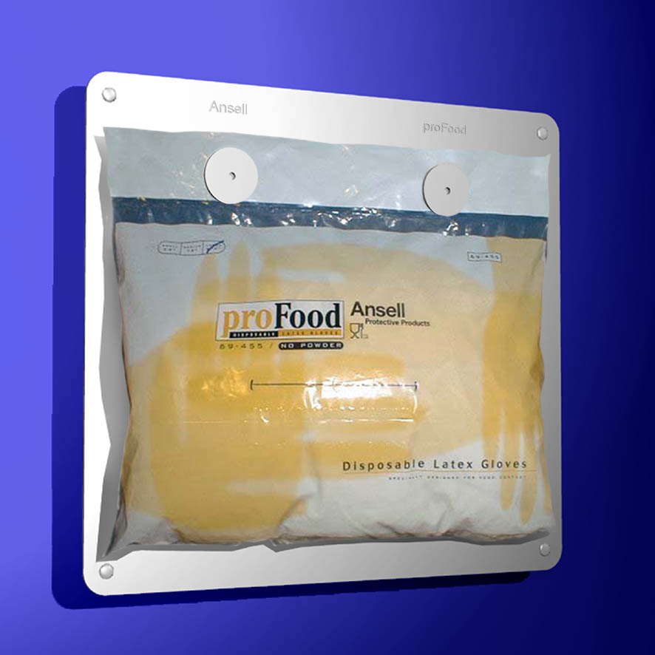
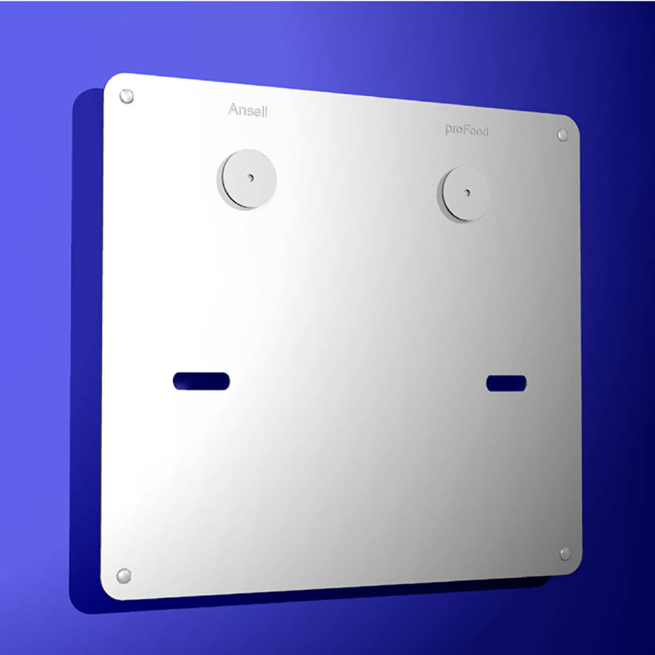
Specifični držač dispenzera
napravljen od 18-10 nehrđajućeg čelika,
dizajniran kao odgovor na sve strože zahtjeve industrije hrane,
lagana upotreba, čišćenje, i promjena poly-vrećica.
Notes:
Comments
- Horizontal or Vertical installation
- Quick refill

Slide 38
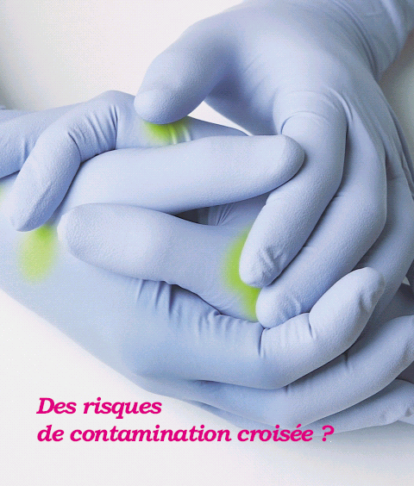

Rizik prelazne kontaminacije ?
proFood premium – višebojni raspon
identificiranje procesa, radnih područja, odjela,
izbjegavanje prijelazne kontaminacije između raznih aplikacija,
osigurati pravu boju koja ide sa odjećom pri posluživanju kupaca.
Notes:
Risk of cross contamination ?
Or
A system of glove color management that helps differentiate applications.
The multiple colors of the proFood premium range help to control the use of gloves, in your plan, according to the different process steps, of working areas or in relation with workers suits.
This system help your company to respect the HACCP plan requirements.

Slide 39
Ansell
proizvodni raspon rukavica
Notes:
Theme : Secure your customer trust
Top 3 features
- powder free
- plasticizers free
- carton free

Slide 40
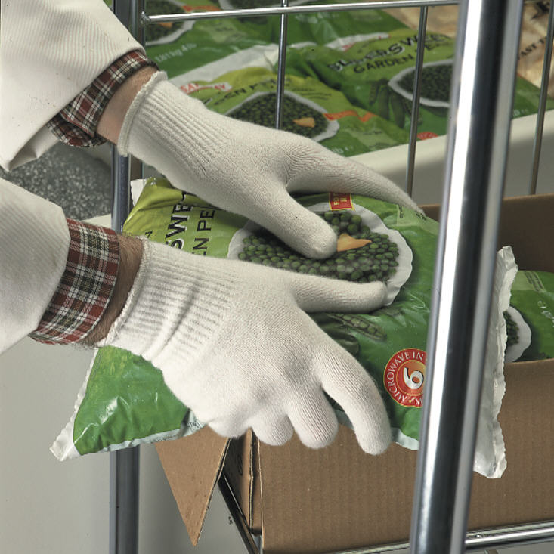
78-110 pleteni ThermaStat
Rukavica od 100 % Thermastat vlakna,
lagana, rastezljiva termička zaštitna rukavica,
Brzo uklanjanje znojenja kroz vlakna (zadržava se tjelesna temperatura),
Mogu se prati na 40°C,
Pakirane u paru,
Primjene: kao rukavica koja se nosi ispod čvršće rukavice u procesiranju mesa i ribarskoj industriji, u rashlađenim i hladnim uvjetima...
Notes:
Series 100 - Heat and Cold Resistant Gloves

Slide 41
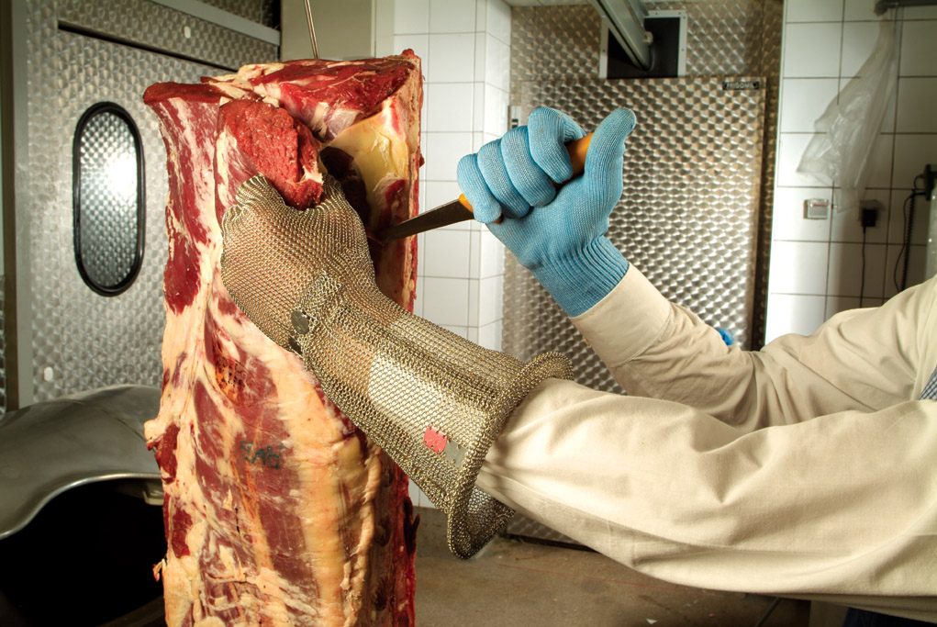
Pletene Spectra rukavice i rukavi
100 % bijela Spectra vlakna
rukavice: lagane, lagano/srednja ili srednja težina,
rukavi: dobavljivi u veličinama od 25 ili 50 cm,
lagane ili srednje težine,
Odgovarajuće za kontakt sa hranom,
Mogu se prati do 95°C,
Pakirane u komadu,
Primjene
Skidanje mesa s kostiju i rezanje,
Procesiranje povrća i voća,
Catering i distribucija hrane.
Notes:
200 Series Knitted Cut resistant gloves

Slide 42
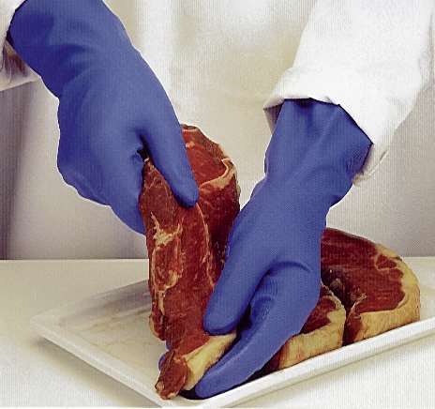
Filcani Nitrile
100 % čista nitrilna rukavica sa filcem,
Odgovarajuća za kontakt sa svom masnom hranom,
Izvrsna mehanička i kemijska zaštita,
Pakirane u paru,
Primjene
Procesiranje peradi, govedine i svinjetine,
Procesiranje voća i povrća.
dostupne u
37-350
37-355
Notes:
300 Series Re-Usable gloves

Slide 43
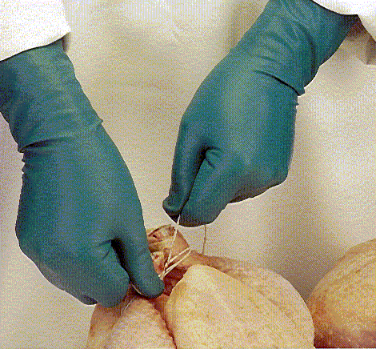
79-340 tanki filcani Nitrile
100 % čista zelena nitrilna rukavica sa filcem,
Specijani tretman rukavice iznutra da bi se smanjio rizik od alergije,
Odgovarajuća za kontakt sa svim masnim hranama,
Odlična fleksibilnost čak i u hladnim uvjetima,
Traje duže od prirodne gume (1/3) u kontaktu sa mesom ili ribom,
Pakirane u paru,
Primjene
Procesiranje peradi, govedine i svinjetine,
Procesiranje ribe,
Kućepaziteljski poslovi.
Notes:
300 Series Re-Usable gloves

Slide 44
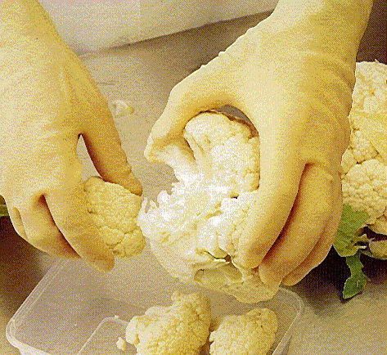
prirodni Latex
Rukavica od 100 % čistog latexa sa filcem od pamuka,
Specijalni unutarnji tretman za smanjenje rizika od alergije,
Pakirane u paru,
Primjene
Procesiranje peradi, govedine i svinjetine,
Procesiranje ribe,
Procesiranje voća i povrća.
dostupne u
87-300
87-305
Notes:
300 Series Re-Usable gloves

Slide 45
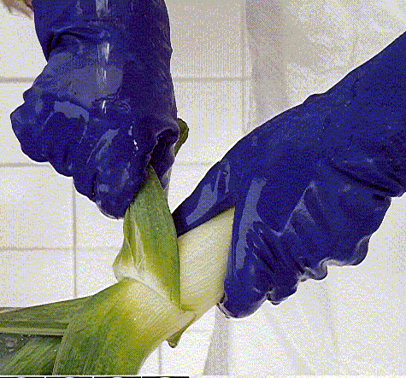
87-315 plavi Latex
Rukavica od 100 % čistog latexa sa pamučnim filcem,
Specijalni tretman izvana i iznutra za smanjenje rizika od alergija i povećanje mehaničke i kemijske otpornosti,
Pakirane u paru,
Primjene
Procesiranje peradi, govedine i svinjetine,
Procesiranje ribe,
Procesiranje voća i povrća,
Kućepaziteljski poslovi.
Notes:
300 Series Re-Usable gloves

Slide 46
Višekratne rukavice Sinteza kontakta sa hranom
Nitrile X X X X X X X X
Supported X X X X X X X
Thin X X X X X X X
Latex X X X X X X

Slide 47
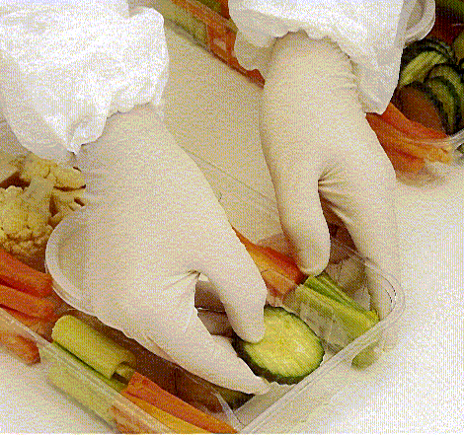
Rukavice od prirodnog latexa bez pudera
Rukavica od 100 % čistog latexa,
Mogu se koristiti sa većinom hrane,
Nude dobru mehaničku otpornost,
Visoka razina fleksibilnosti,
Pakiranje od 100 komada,
kartonski dispenzer
PE poly-vrećica
Primjene
...
dostupne u
69-460 - 24 cm
69-465 - 24 cm
Notes:
Comments
400 Series - Disposable gloves
Textured finish ?
High dexterity
Low level of residual protein
Applications :
- All final stages of meat or fish processing,
- Controlled environment rooms,
- Prepared meals,
- Dairy processing,
- Catering

Slide 48
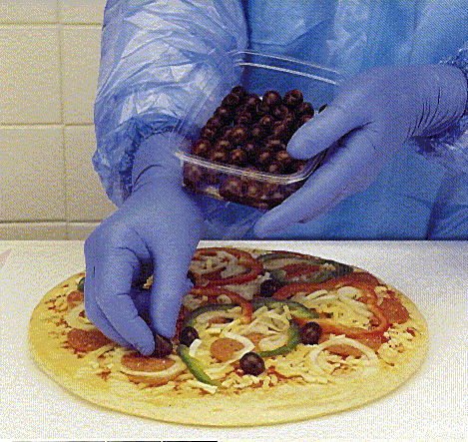
Nitrilne rukavice bez pudera
Rukavica od 100 % čistog nitrila,
Mogu se koristiti sa raznim vrstama hrane,
Nude dobru mehaničku otpornost,
Dobro ergonomsko prijanjanje,
Bez proteina latexa = alternativni proizvod za alergičnu osobu,
Pakirane po 100 komada,
kartonski dispenzer
PE poly-vrećica
Primjene
...
dostupne u
92-470 - 24 cm
92-471 - 24 cm
92-472 - 24 cm
92-481 - 30 cm
Notes:
Comments
Serie 400 - Disposable gloves
- 30 cm variant for most demanding applications, for “clean-room” final packaging or liquid foods
Nitrile Textured finish powder free glove
Blue color to help
Mechanical and chemical protection
Comfort and Dexterity
No natural rubber
Applications :
- All final stages of meat or fish processing,
- Controlled environment rooms,
- Prepared meals,
- Dairy processing,
- Catering

Slide 49
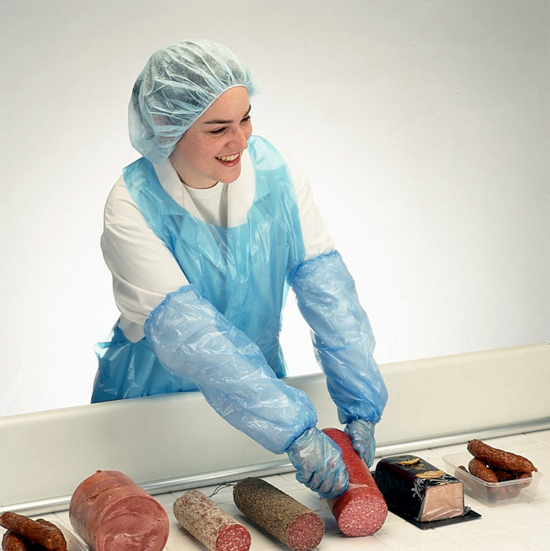
Polietilenski rukavi
100 % čisti PE rukavi,
Zaštita podlaktica,
Kompatibilne sa svim vrstama odjeće,
Lagani za korištenje,
Mali trošak,
Pakirane u 500 komada u PE poly-vrećici,
Primjene
...
dostupne u
59-500
59-505
Notes:
500 Series Aprons, Sleeves and Bouffants
Some aprons & bouffants are also available

Slide 50
proFood premium, koju dodatnu vrijednost nude te rukavice?
Kompletan raspon jednokratnih rukavica
Odgovarajuće za sve primjene,
Odobrene za svu hranu,
Dizajnirane da odgovore na vaše potrebe.
Odobrene za kontakt za hranom
Bez plastifikatora
Bez pudera
Bez kartona
Više dužina
Nekoliko boja
Pakirane u polietilenske poly-vrećice

Slide 51
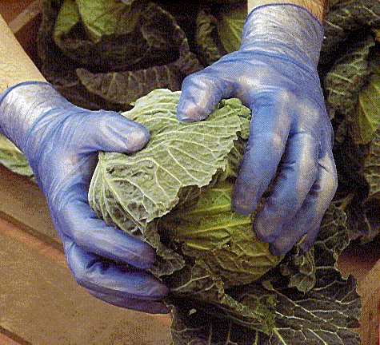
34-425 plavi pudrani Vinyl
PVC rukavica,
Napudrane,
Rastezljive rukavice za poboljšanje udobnosti,
Pakirane po 100 komada u kartonskom dispenzeru,
Primjene
Zadnji koraci u procesiranju voća i povrća, bez masnih aditiva

Slide 52
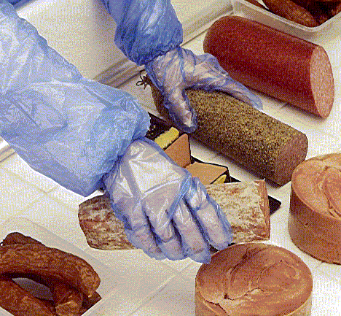
35-405 plave bez pudera PE
Polietilenska rukavica,
Odgovarajuća za kontakt sa svom masnom hranom,
Jeftin izbor,
Pakirane po 500 komada u kartonskom dispenzeru,
Primjene
Distribucija hrane,
Catering,
Sve finalne faze procesiranja mesa i ribe,
Pripremljena jela,
Procesiranje mliječnih proizvoda.

Slide 53
Jednokratne rukavice Sinteza kontakta sa hranom
PVC X X X
PE X X X X X X X X
Latex X X X X X X
Nitrile X X X X X X X X

Slide 54
Komunikacija i tržišna aktivnost

Slide 55

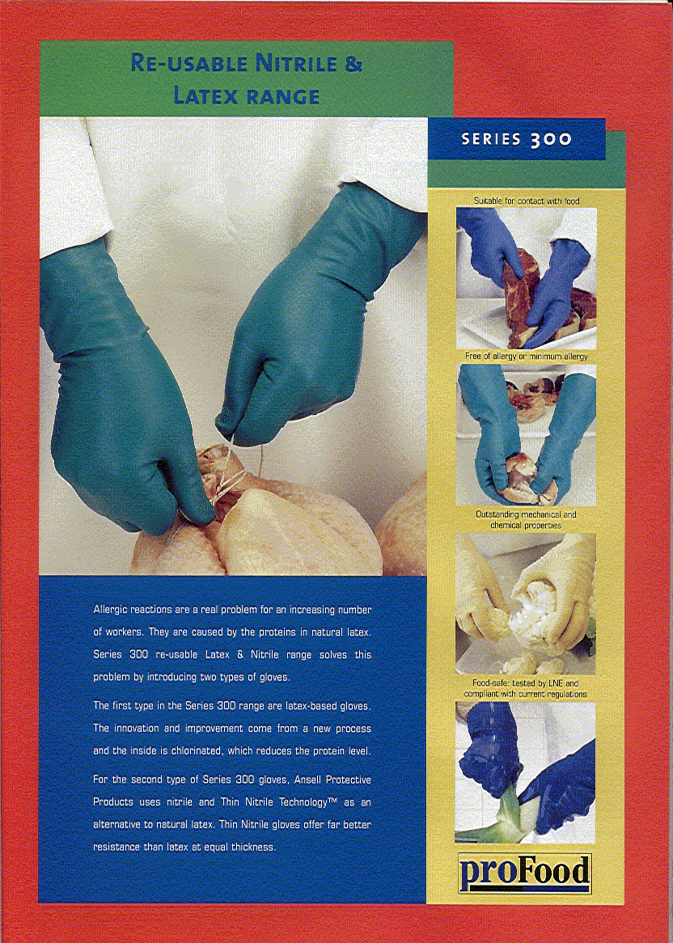
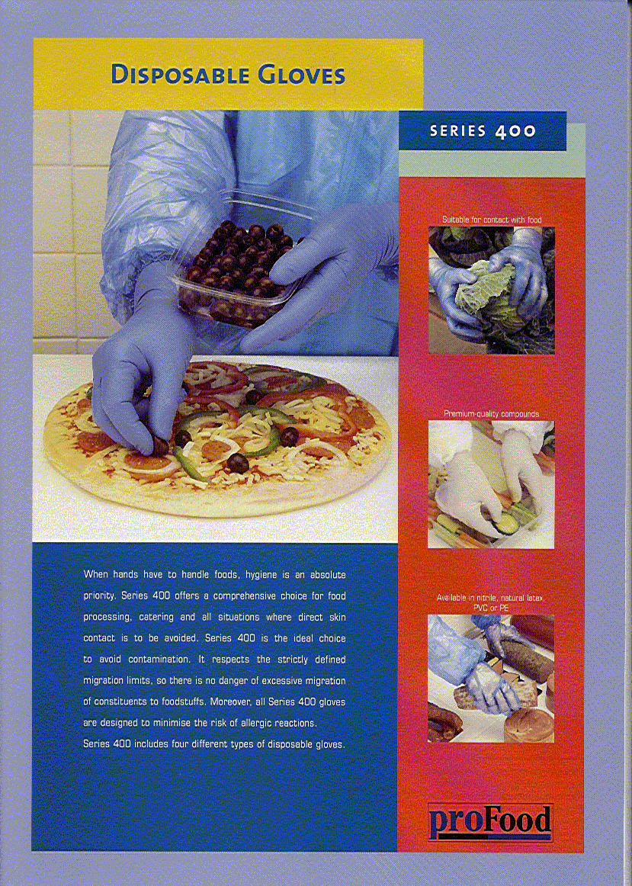
proFood folder i štampani listovi o proizvodu

Slide 56
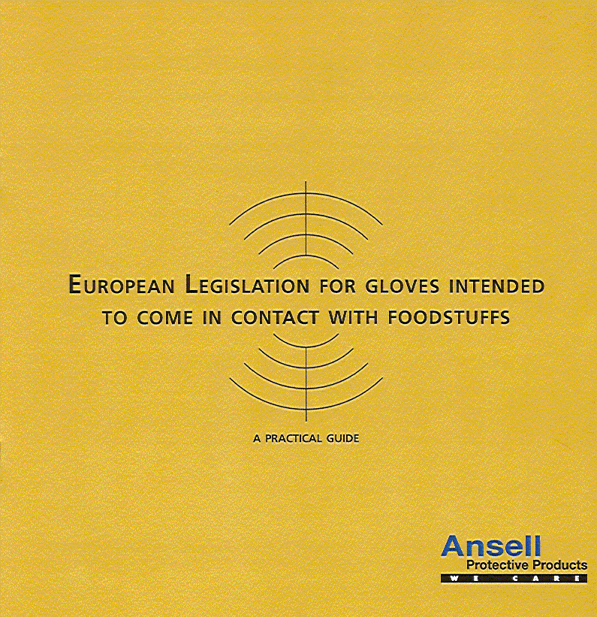
Vodič o regulativama

Slide 57
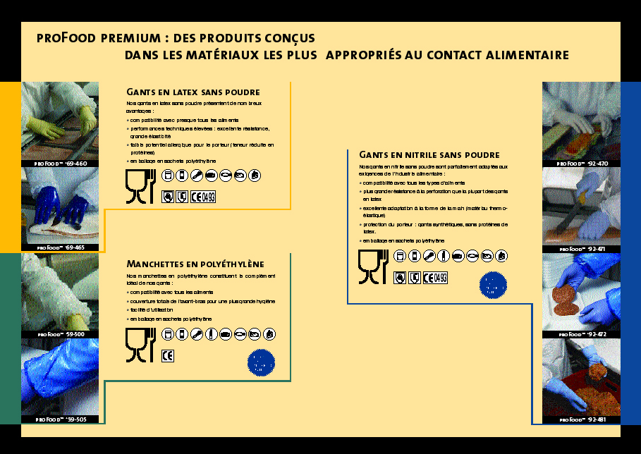

Brošura proFood premium

