Slide 1
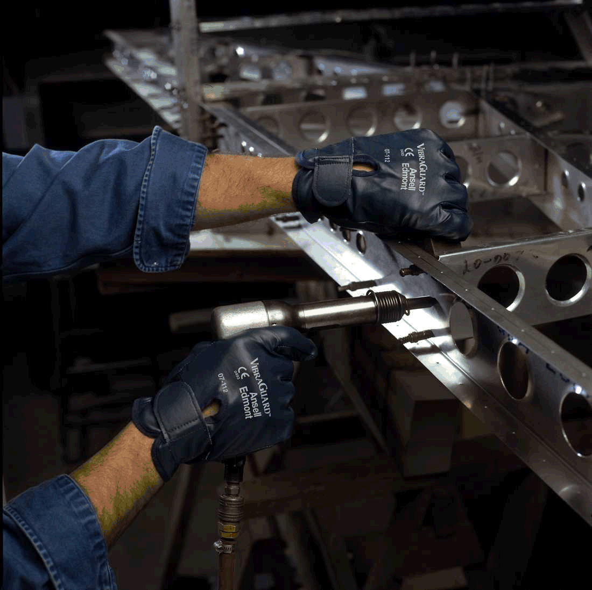
Kako zaštititi ruke radnika od vibracija u njihovom radnom okruženju
Ansell Industrijski program

Slide 2
Primjene gdje radnici mogu biti izloženi vibracijama
Građenje kuća i konstrukcija
Ljevaonice i metalna industrija
Šumarstvo i agrikultura
Drvna industrija i proizvodnja namještaja
Transport i javne ustanove
Proizvodne industrije
Kamenolomi, miniranje
Rotirajući i perkusativni ručni alati: bušilice, orbitalni i rotirajuće-orbitalni alati za pjeskarenje, razanje metala, čekićar, pneumatska bušilica
Vibrirajući radni dijelovi koje opreratori drže u ruci,
Vibrirajući strojevi,
Vibrirajuće kontrole koje se drže rukom: rukohvati na motoru, volani na vozilima, moto-kultivatori
Notes:
Important factors that can cause health’s troubles :
- intensity of vibrations (the more intense the vibrations, the more energy will be transmit to the body through hands and fingers),
- direction of the vibrations (vertical, horizontal, …),
- duration of the exposure (the longer the exposure, the more chance the worker has to suffer form vibration’s effects),
- composition in frequencies of the vibrations : spectrum.
Translation
Sander = ponceuse
Drill : fraiseuse
Handlebar : guidon
Shear : cisaille

Slide 3
Posljedice na zdravlje radnika
Pretjerana izloženost štetnim vibracijama (od 8 do 1000 Hz) može prouzročiti nekoliko poteškoća i poremećaja zdravlja uglavnom na gornjim ekstremitetima (šaka i ruka) :
protok krvi u šakama: Raynaudov fenomen ili bijeli prsti (uzrokovani vibracijom),
neurološki poremećaji,
poremećaji mišića i kostiju.
Od 1,7 do 3,6 % radnika u Europi su izloženi štetnim vibracijama koje se prenose preko ruku.
Vibracijski sindrom
šaka-ruka
Notes:
White finger disease : Initially attacks of blanching involve the tips at one or more fingers, but with continued exposure to vibration, the blanching can extend to the base of the fingers. Sometimes an attack of blanching is followed by cyanosis. In the recovery phase, redness, eventually associated with pain, may appear in the affected fingers as a result of a reactive increase of blood flow in the cutaneous vessels (can be accelerated by warmth or local massage).
The duration varies with the intensity of the triggering stimuli and last from a few minutes to more than one hour.
If vibrations exposure continues, the blanching attacks become more frequent and may occur all year around.
During the attack, the affected workers can experience a complete loss of touch sensation and manipulative dexterity, which can interfere with work activity increasing the risk for acute injuries due to accidents.
Neurological disorders : Workers may experience tingling and numbness in their fingers and hands. If vibration exposure continues, these symptoms tend to worsen and can interfere with work capacity and life activities. Workers may exhibit a reduction in the normal sense of touch and temperature as well as an impairment of manual dexterity at the clinical examination. A reduction of the vibration sensitivity of the skin of the fingertips may be also found.
Workers may sometimes show signs and symptoms of entrapment neuropathies, such as carpal tunnel syndrome (CTS), a disorder due to compression of the median nerve as it passes through an anatomical tunnel in the wrist. It is believed that ergonomic stressors acting on the hand and wrist (repetitive movements, forceful gripping, awkward postures), in combination with vibration can cause CTS in workers handling vibrating tools.
Musculoskeletal disorders : In some countries, bone and joint disorders occurring in workers using hand-held vibrating tools are considered to be an occupational disease and the affected workers are compensated.
Workers with prolonged exposure to vibration may complain of muscular weakness, pain in the hands and arms, and diminished muscle force. It has also been found to be associated with a reduction of hand-grip strength --> can cause disability.
Tendinitis and tenosynovitis (inflammation of tendons and their sheaths) have been reported : seem to be related to ergonomic stress factors arising from heavy manual work and the association with hand-transmitted vibration is not conclusive.

Slide 4
Kako zaštititi radnike od vibracija?
Primjena ergonomskih pravila pri dizajniranju alata i mašina radi smanjenja potrebne snage potrebne da bi se napravio posao.
Zamjena alata/strojeva koji prouzročuju prevelike vibracije sa boljim strojevima.
Periodično i regularno održavanje alata/strojeva.
Organiziranje aktivnosti radnika tako da se izmjenjuju periodi izloženosti vibracijama sa periodima bez izloženosti.
Nabaviti rukavice koje zaštićuju od vibracija.
Informiranje radnika o rizicima izlaganja vibracijama i uvježbavanje ljudi da ispravno koriste alate/strojeve i zaštitne rukavice.
Praćenje zdravlja radnika sa preventivnim periodičnim sanitarnim kontrolama, koje provodi doktor zadužen za industrijska oboljenja.
Notes:
Employers have to protect the health of their workers : Directive 89/391/EEC on the introduction of measures to encourage improvements in the safety and health of workers at work
Personal Protective equipment can be a solution. Then the employers has to select the right equipment according to directive 89/656/EEC : risk assessment, choice and provide it to workers.

Slide 5
Što antivibracijske rukavice omogućuju radniku?
Zaštita protiv vibracija: limitiranje prijenosa vibracija na šaku-ruku i zaštita od razvijanja bolesti.
Zaštita od traumatskih događaja: izbjegavanje abrazije kože, posjekotina i probadanja, a isto tako odbija masti i ulja.
Zaštita od hladnoće: osigurava odgovarajuću temperaturu kože.
Osigurava bolji zahvat: u suhim, mokrim i uljnim situacijama.
Notes:
The gloves are useful to protect the fingers and the hand from traumatic events and to maintain a satisfactory cutaneous temperature.
Prevention includes technical measures aimed at elimination or reduction of hand-transmitted vibration at the source, appropriate information and advice to employers and employees, instruction to adopt safe and correct work practices, and medical preventive guidance.
Efficient protective gloves can be given to employees.
Correct work planning and good rest conditions can also improve the prevention, I.e. a 10 minutes rest period per hour in a warm environment for forestry work.

Slide 6

Zahtjevi za rukavice
CE tip pregleda u skladu sa zakonom o osobnim zaštitnim sredstvima 89/686/CEE – srednji stupanj rizika
Usklađenost sa EN ISO 10819 standardom : “Metoda za mjerenje i procjenu prijenosa vibracija rukavica na dlan ruke”.

Slide 7
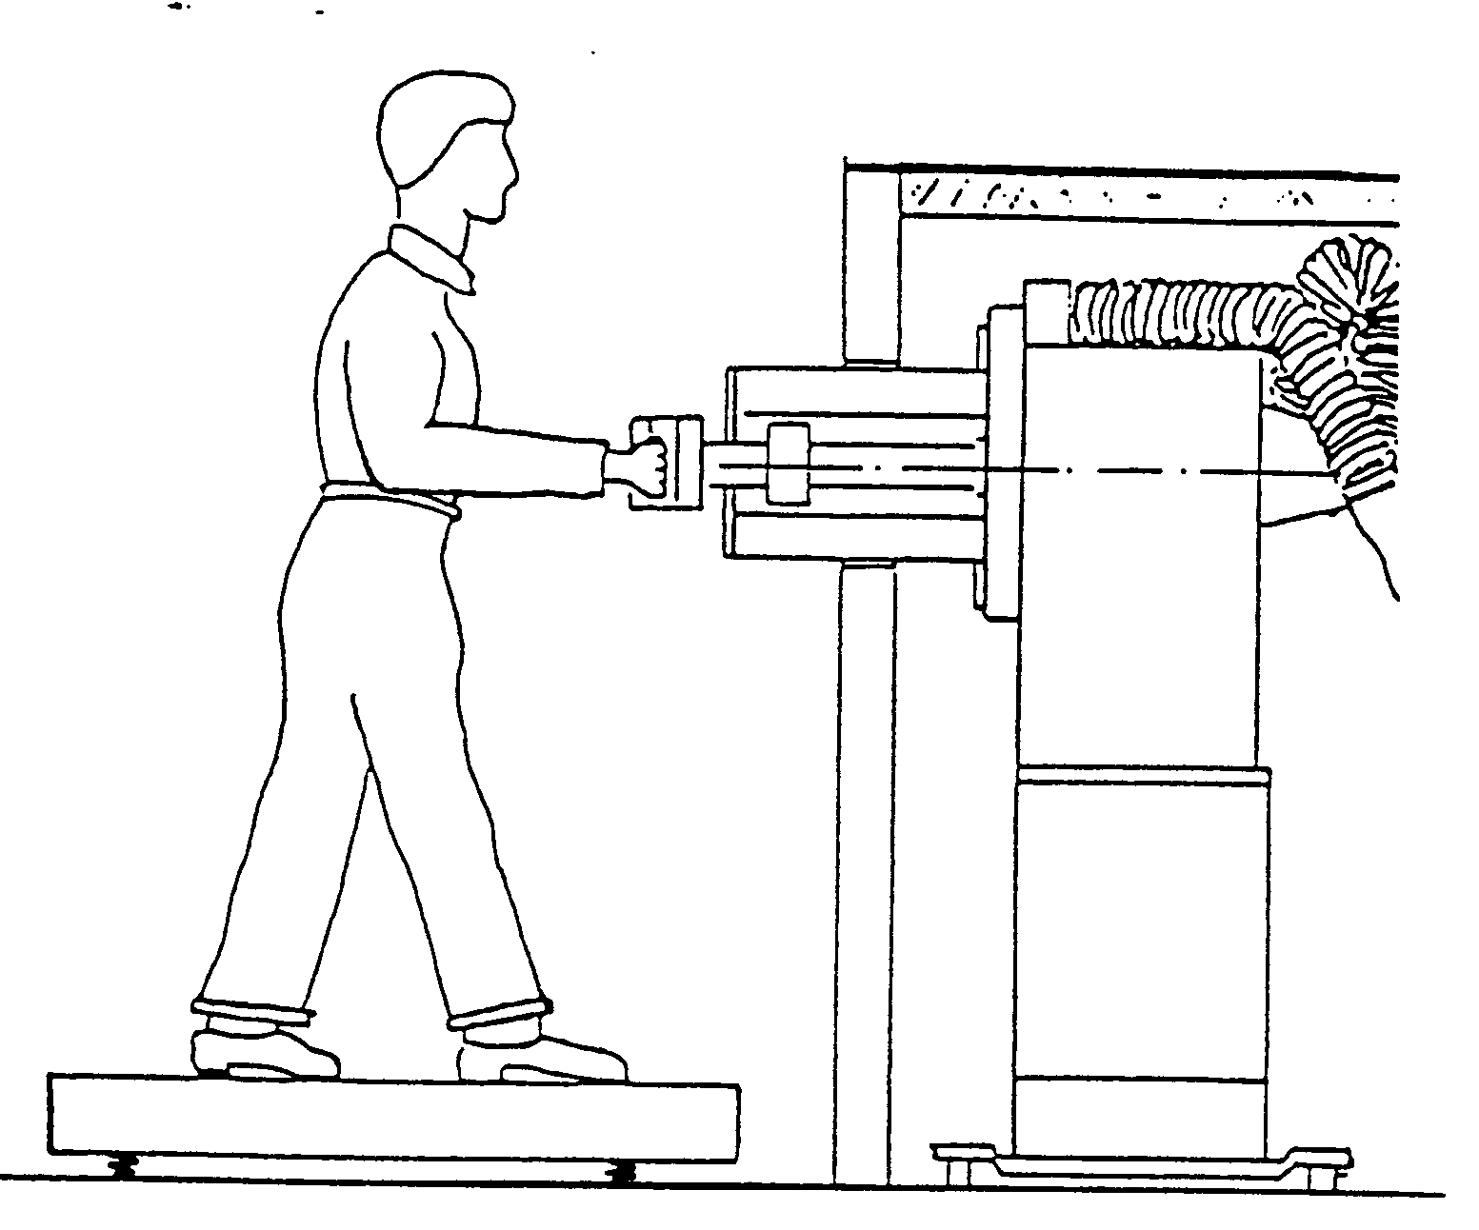
EN 10819 Metoda za mjerenje i procjenu prijenosa vibracija rukavica na dlan ruke
Ova metoda prenosi mehaničke vibracije i udarce na operatera koji drži šipku zahvatom od 30 N. Mjerenje i procjena prijenosa vibracija rukavica na dlan ruke se vrše u rasponu frekvencija od 31.5 do 1250 Hz.
Notes:
With the actual knowledge, most of the glove on the market don’t provide any protection with frequencies inferior to 150 Hz. Even some gloves amplify vibrations transmission to the system hand-arm.
Nevertheless, gloves help keep hands dry and warm that limit the vibration effects.
The test doesn’t measure the vibration transmission in the finger area

Slide 8
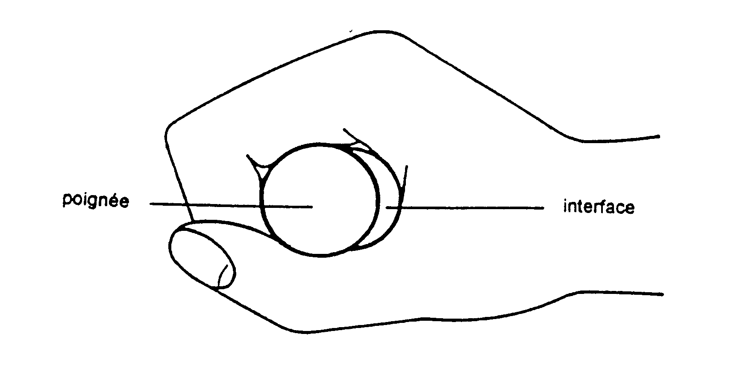
EN 10819 Metoda za mjerenje i procjenu prijenosa vibracija rukavica na dlan ruke
Mjerenja se rade sa golom
rukom i sa rukavicom na ruci.
Zahtjevi su:
Nema povećanja vibracija
u srednjem frekvencijskom
rasponu (31.5 - 200 Hz),
Smanjenje minimum 40 % u visokom frekvencijsom rasponu(200-1250 Hz).
Zaštitno područje rukavice mora pokriti, bez prekida, cijelo područje od dlana
do prstiju.

Slide 9

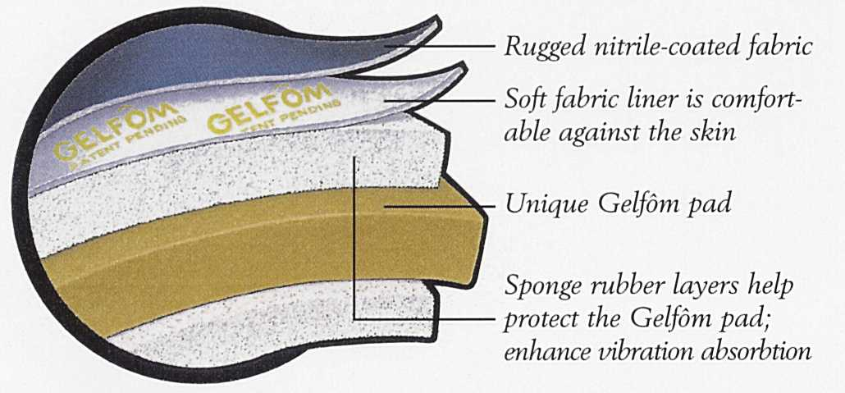
Ansell rješenje: VibraGuard
Rukavica napravljena od Gelfôm podloge i spužvastih gumenih slojeva da
se osigura zaštita od visokofrekventnih vibracija preko 20 Hz.
(usklađenost sa EN 10819).
Šivana nitrilna rukavica, bez silikona, štiti Gelfôm podlogu, nudi vrlo dobru mehaničku otpornost i odbija ulje i mast. Isto tako nudi dobar mokri i suhi zahvat.
Ovaj proizvod ima fantastičnu fleksibilnost a istovremeno osigurava odlično pristajanje.
3 2 2 1
Notes:
Features Benefits
1 - Ergonomic design
1 - The Vibraguard anti-vibration pad is designed with grooves which match the natural contours of the hand. This provides enhanced flexibility and reduces hand fatigue, thus improving worker comfort and efficiency.
2 - Fantastic flexibility
2 Research shows that only 1 % of vibration is transmitted to the wrist at high frequencies of 500 Hz or over. Vibraguard was therefore designed in a driver-style pattern to alleviate the restriction associated with wrist supports whilst still ensuring a close, secure fit.
3 - Broad frequency Protection
3 - Vibraguard offers premium protection at high frequencies combined with protection across a broad spectrum of frequencies. This is reflected in the EN ISO 10819 test result, which Vibraguard passed convincingly, demonstrating protection from 20 Hz upwards.
4 - Full-finger protection
4 - Vibraguard provides full-finger protection. Research has proved that vibration is localised to the palm area for frequencies above 300 Hz and is acutely focused in the finger area as the frequency increases. By equipping your workforce with Vibraguard, you are greatly reducing their risk of developing HAVS
5 - Mechanical performance
5 - Vibraguard is made with Ansell's unique nitrile formulation, offering outstanding resistance to cuts, punctures and abrasion and repelling grease and oil.
6 - Silicone free
6 - Vibraguard is made from silicone-free materials. This is a major benefit, especially in the steel and motor industries

Slide 10
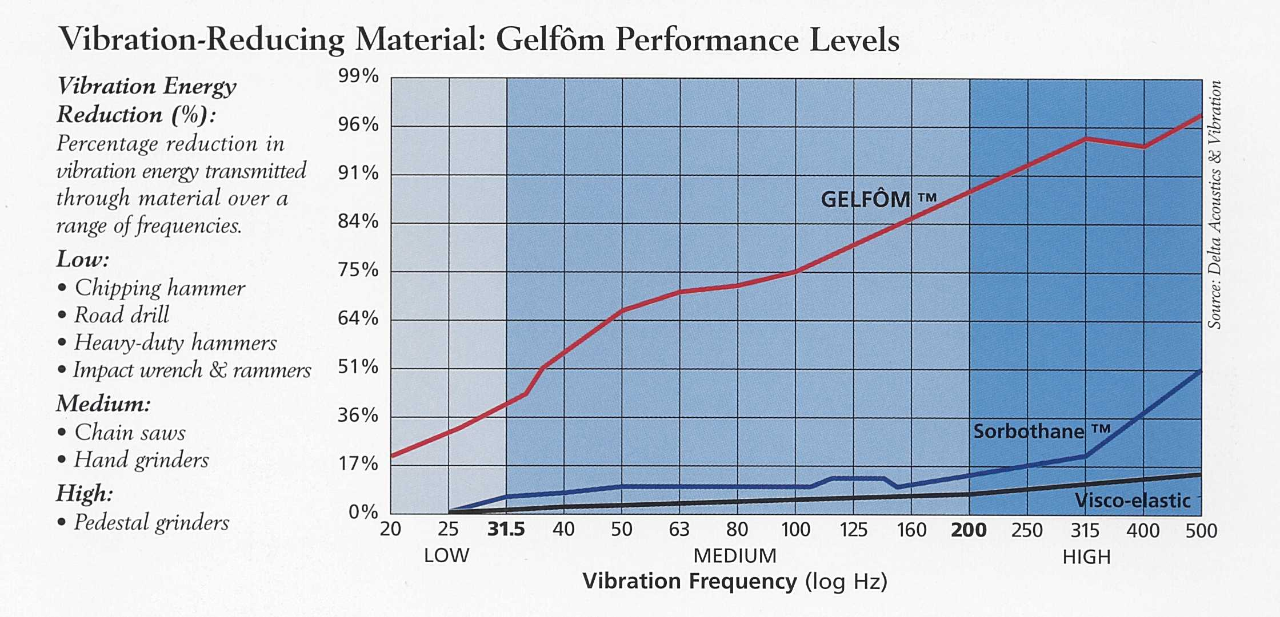
Preko 500 Hz, manje od 1 % vibracija
se prenose na šaku i ruku.

Slide 11
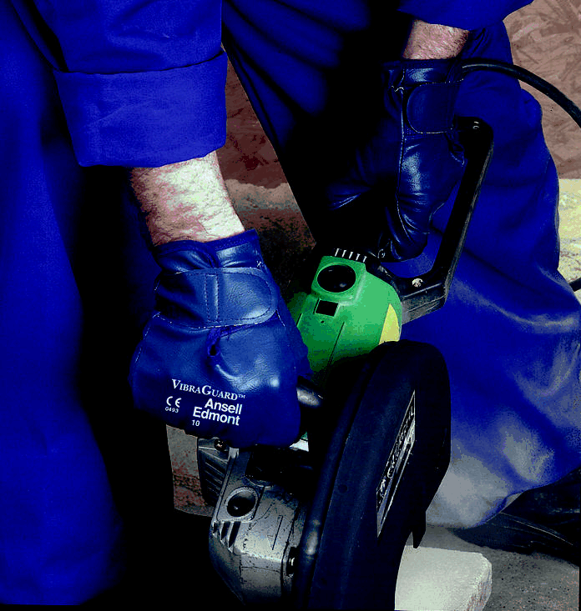
Razlozi za odabir Ansell-ove VibraGuard rukavice
Zaštitna rukavica
Široki raspon zaštite od frekvencija
Potpuna zaštita prstiju i dlana
Dobre mehaničke performanse
i dobar zahvat
Bez silikona
Udobna rukavica
Ergonomski dizajn
Fantastična fleksibilnost
Ansell-ova kvaliteta, pouzdanost i usluge
Notes:
Best - Vibrex
North - Zorber II

